Slide 1

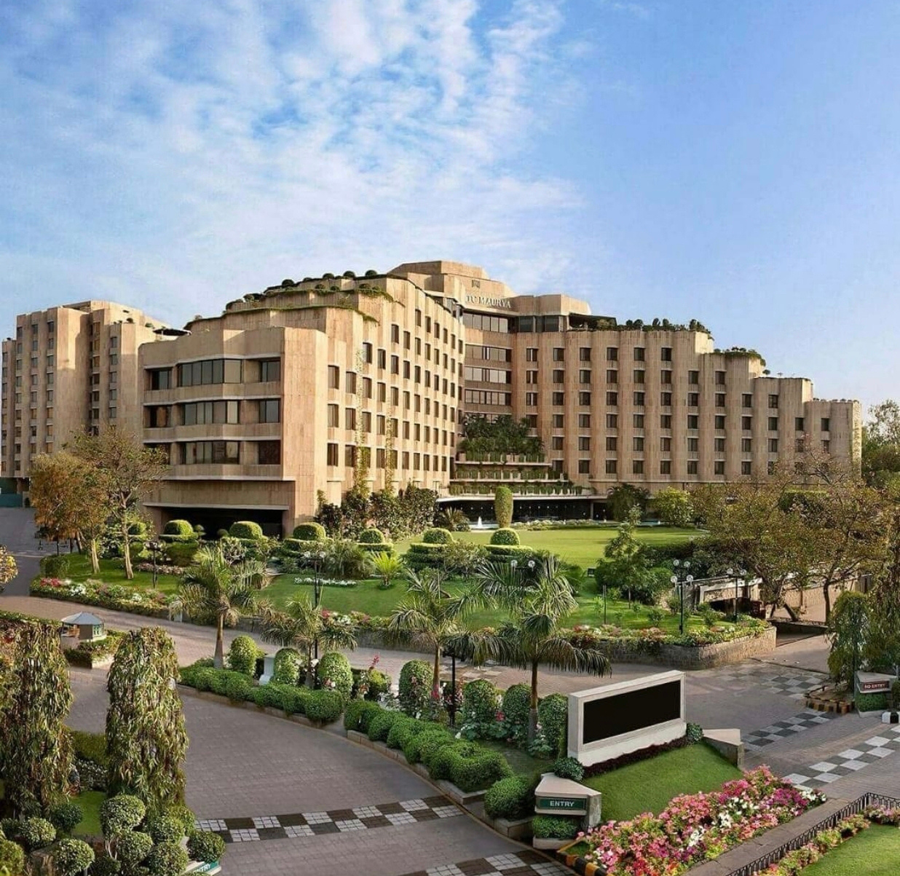

ITC HOTELS
Home
About
Contact
ITC HOTELS REVENUE OPTIMIZATION
POWER BI PROJECT
Presented By- PARUL KOKCHA

Slide 2
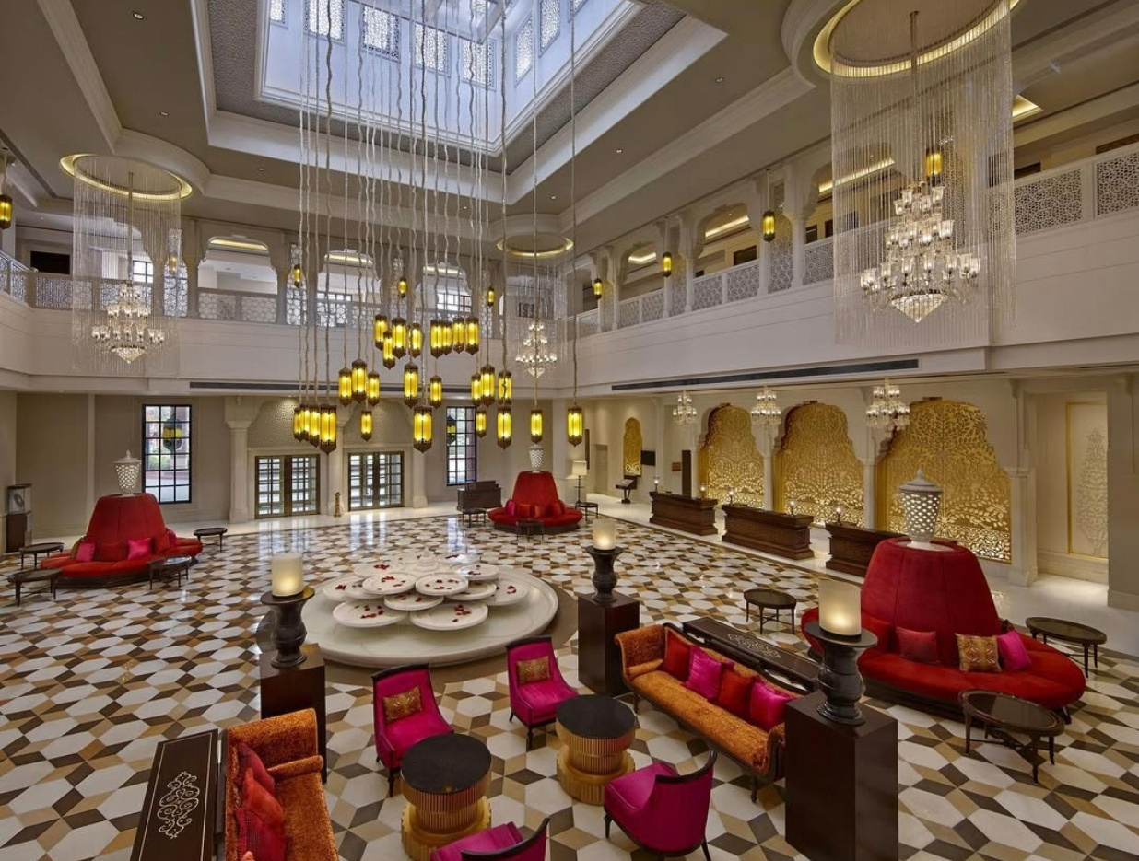
ITC HOTELS
Home
About
Contact
About Us
Established in 1975, ITC Hotels has grown to encompass over 140 hotels across 90+ destinations, solidifying its presence in the Indian subcontinent.ITC Hotels seamlessly blends India’s rich tradition of hospitality with globally benchmarked services, offering a collection of hotels and resorts that reflect the unique culture and ethos of each destination. Notably, ITC Hotels is the first in India to be awarded the 2024 US Green Building Council Leadership Award for Organisational Excellence.

Slide 3
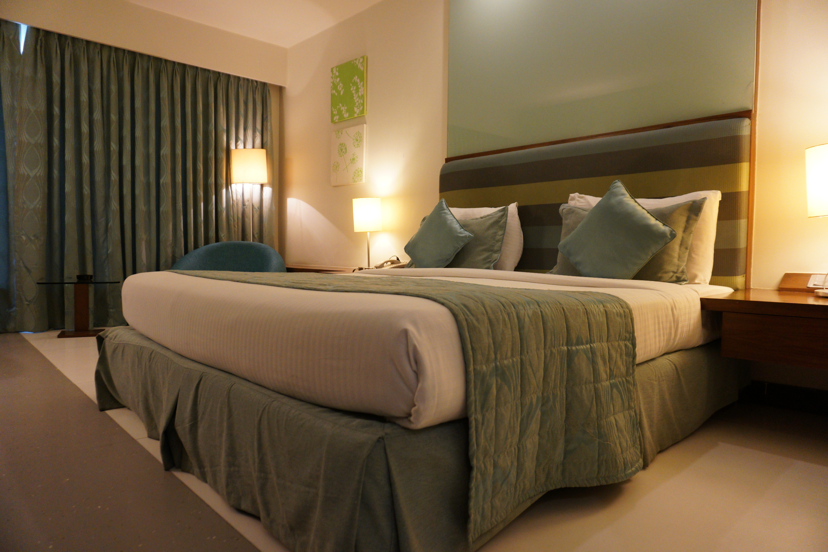
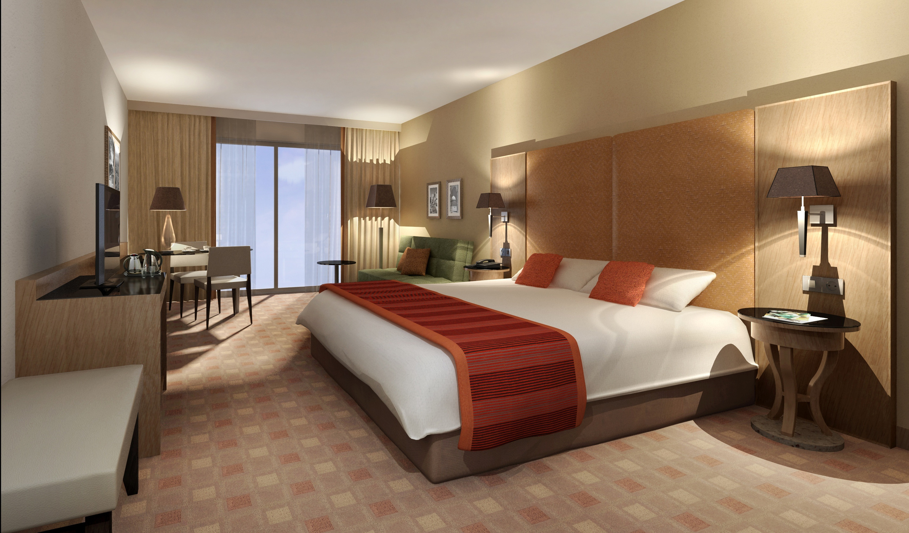
ITC HOTELS
Home
About
Contact
Problem Statement
ITC Hotels is a luxury hotel chain that operates multiple properties with diverse room categories and varying occupancy rates. The company wants to gain deeper insights into its overall financial performance, customer booking behavior, occupancy trends, and room category performance to optimize revenue generation, minimize cancellations, and enhance customer satisfaction. The goal of this project is to create an interactive, multi-page Power BI dashboard to provide stakeholders with real-time insights for decision-making.

Slide 4
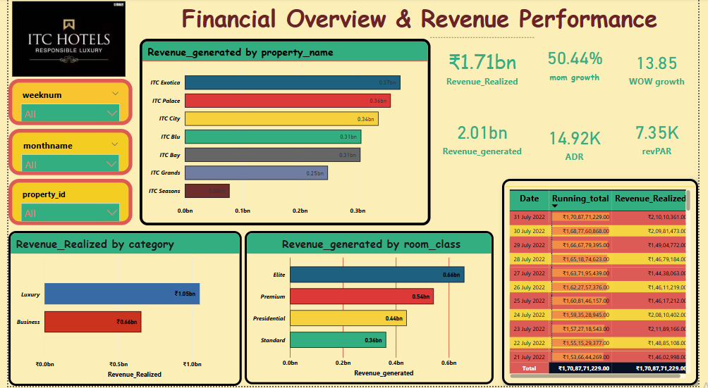
1.Financial Overview & Revenue Performance

Slide 5
Financial Overview & Revenue Performance
1.Total Revenue & Revenue Distribution
₹1.71 billion in total revenue realized.
Major properties like ITC Exotica, ITC Palace, and ITC City are the top contributors.
Revenue varies significantly across properties, indicating different performance levels across hotel locations.
2. Revenue by Category
Luxury category outperformed Business with ₹1.05 billion vs. ₹0.66 billion realized.
3. Room Class Revenue Insights
Premium and Elite room classes dominate revenue generation.
4. Growth Metrics (MoM and WoW)
Month-over-Month (MoM) growth is strong at 50.44%.
Week-over-Week (WoW) growth is 3.85%, indicating consistent weekly improvement.
5. Cumulative Revenue Tracking
Daily tracking table shows a running total of revenues growing steadily, indicating good cumulative momentum.
6. Key Operational Metrics
Average Daily Rate (ADR) is ₹14.92K, suggesting strong pricing power.
Revenue per Available Room (RevPAR) is 7.35K, a healthy metric reflecting occupancy and room rates combined.

Slide 6
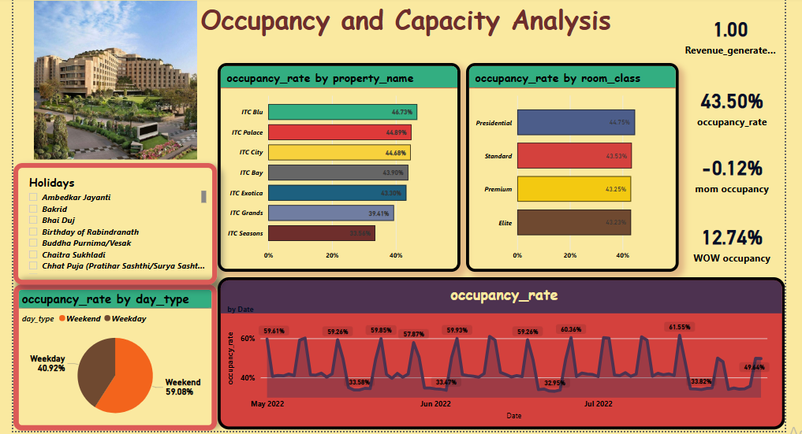
2. Occupancy & Capacity Analysis

Slide 7
Occupancy & Capacity Analysis
1. Overall Occupancy Performance
Current Occupancy Rate: 43.50%
Month-over-Month (MoM) Occupancy Change: -0.12% (slight decline)
Week-over-Week (WoW) Occupancy Growth: +12.74% (strong improvement)
2. Occupancy by Property
Highest occupancy: ITC Blu at 46.73%
Lowest occupancy: ITC Seasons at 33.56%
3. Occupancy by Room Class
Presidential rooms have the highest occupancy (44.75%).
Elite rooms have the lowest occupancy at 43.23%.
4. Seasonal & Day-wise Trends
Weekend Occupancy: 59.08%
Weekday Occupancy: 40.92%
Stronger occupancy observed on weekends, indicating weekend demand surge.
5. Occupancy Trend Over Time
Visible peaks during weekends and holidays (around 59% occupancy spikes).
Lowest dips around 32%-33%, suggesting opportunity to boost weekday rates and promotions.

Slide 8
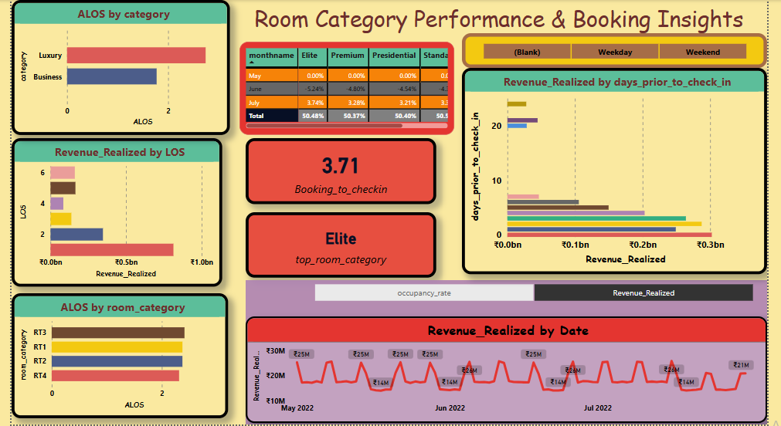
3. Room Category Performance and Booking Insights

Slide 9
Room Category Performance & Booking Insights
1Top Revenue-Generating Room Categories:
. Elite is identified as the top-performing room category in terms of revenue realization.
Luxury rooms have higher ALOS (Average Length of Stay) compared to Business rooms.
2. Booking Patterns Impact:
Revenue is concentrated for bookings made closer to the check-in date (mostly within 10 days prior).
3. Average Length of Stay (ALOS
Luxury category guests tend to stay longer than Business category guests.
KPIs Highlighted
Average Length of Stay (ALOS) by category and by room type.
Booking Lead Time: 3.71 days.
Revenue Realized:
By LOS (length of stay).
By Days Prior to Check-in.
By Date (trend line across months)

Slide 10
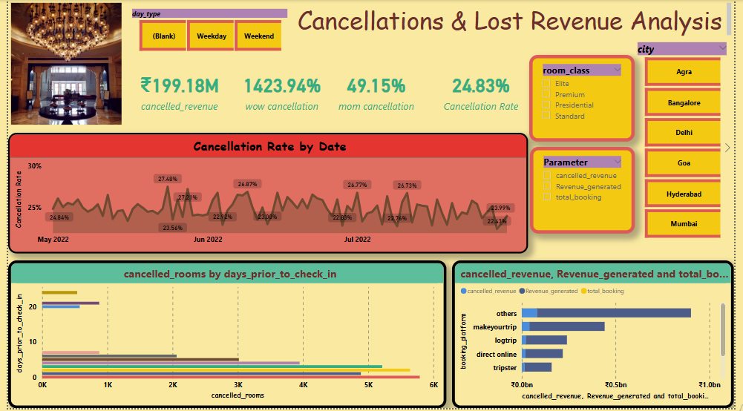
4. Cancellations & Lost Revenue Analysis

Slide 11
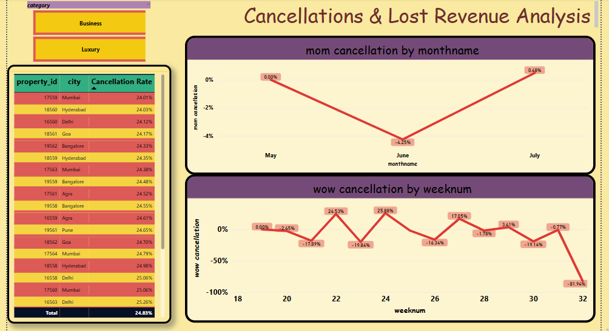
4. Cancellations & Lost Revenue Analysis

Slide 12
Cancellations and
lost Revenue Analysis Insights
1. Cancellation Rate Overview:
The overall cancellation rate across properties is about 24.83%.
Individual hotel properties show cancellation rates mostly between 24%–25%.
2. Lost Revenue Due to Cancellations:
Total revenue lost from cancellations amounts to approximately ₹199.18M
3. Cancellation Trends (MoM and WoW Analysis):
Month-over-Month (MoM):
June saw a drop in cancellations compared to May (around -4.25%).
July experienced a significant spike in cancellations (around 0.48%).
4. Cancellation Patterns:
Days Prior to Check-in:
Most cancellations occur very close to the check-in date, but some cancellations also happen 10–20 days prior.

Slide 13

ITC HOTELS
Home
About
Contact
Actionable Recommendations
Implement a flexible cancellation and rescheduling policy.
Conduct root cause analysis for high-value room cancellation.
Leverage predictive analytics to mitigate cancellations.
Develop long term stay packages to stabilize occupancy rates.
Use AI-based dynamic pricing to maximize revenue per booking window.
Improve customer retention strategies to reduce last-minute cancellations.
Focus on revenue optimization technique for lower performing strategies.

Slide 14

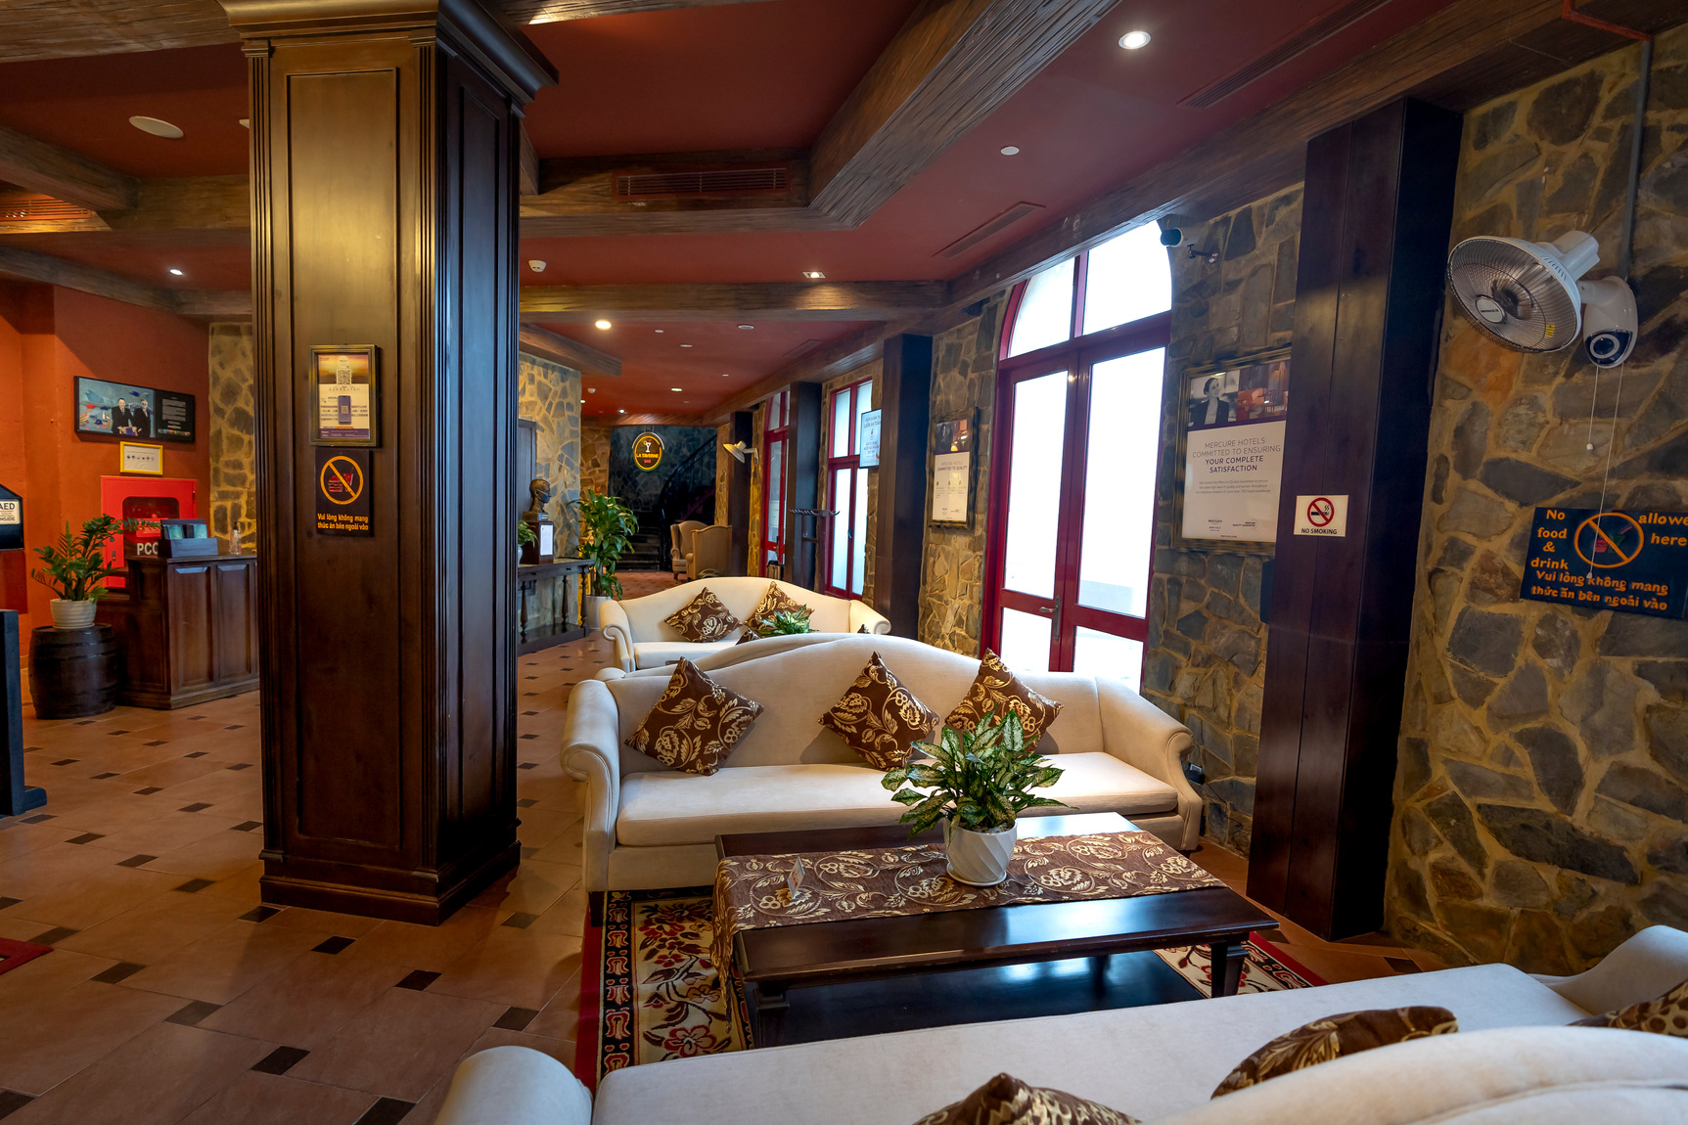
ITC HO
Home
About
Contact
Thank You
FOR YOUR ATTENTION

